Slide 1

How do Organisms
Reproduce?
Modes of reproduction used by single
organisms
(Spore formation, Tissue culture)

Slide 2
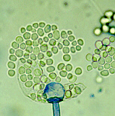
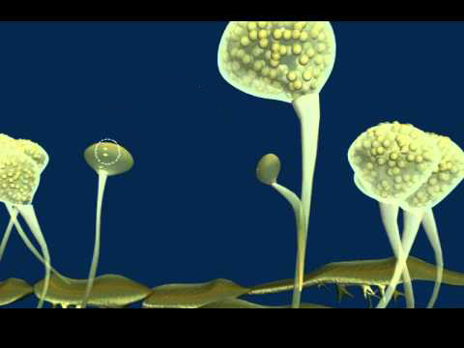
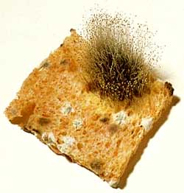
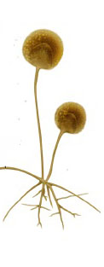
Spore formation
Spores
Seen in bread mould (Rhizopus).
Thread-like structures
Hyphae.
On the hyphae
blobs
sporangia
Spores.
Sporangia
blobs
Hyphae

Slide 3
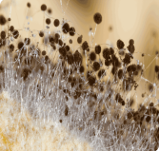
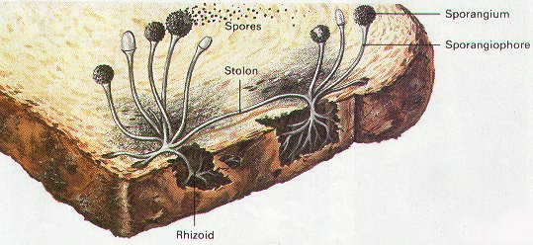
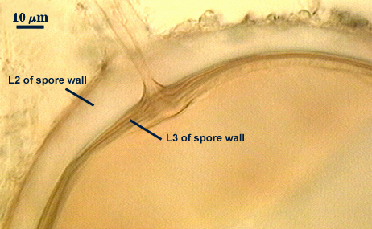
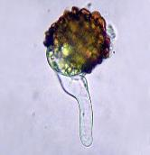
Spore formation
thick walls
The spores are covered with thick walls that protect them.
Spore eventually develop into new individuals.

Slide 4

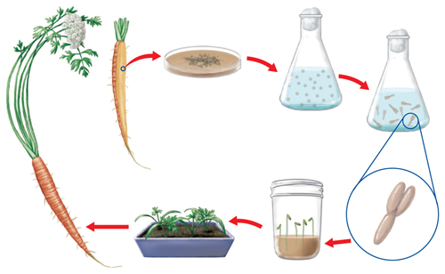

Slide 5


Tissue culture
New plants grow by removing tissue or separating
cells from the growing tip of a plant.
As it contains meristematic tissue

Slide 6



Tissue culture
Nutrient agar
Cells are placed in artificial medium
divide rapidly - small groups of cells – callus.
Undifferentiated tissue
As it contains meristematic tissue

Slide 7
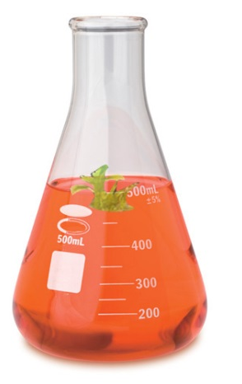
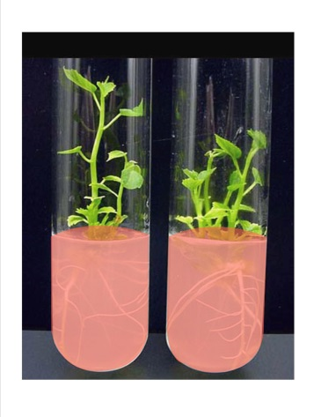
Tissue culture
The callus is transferred to another medium containing hormones for growth and differentiation.
Like auxins, gibberellins, etc.

Slide 8
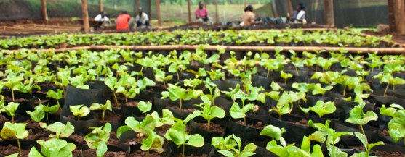
Tissue culture
The plantlets – placed in soil – grow into mature plants.

Slide 9
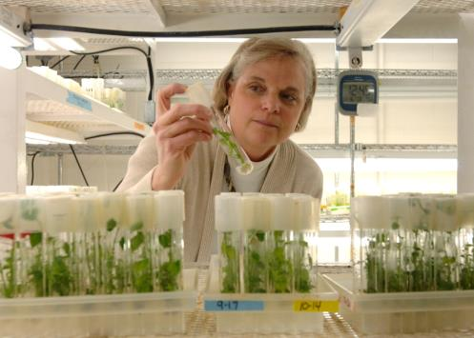
Tissue culture
Using tissue culture, many plants can be grown from one parent in disease-free conditions.

Slide 10
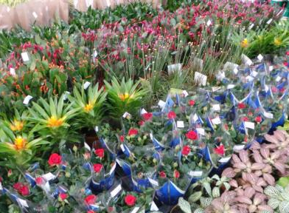
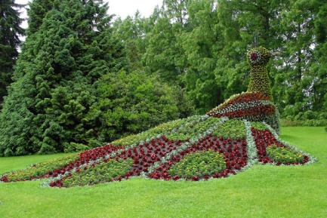
Tissue culture
This technique is commonly used for ornamental plants.

Slide 11

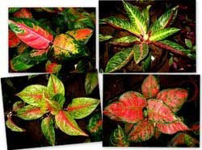
Tissue culture
This technique is commonly used for ornamental plants.

Slide 12
Thank You

